Slide 1


Blockchain Cryptography
LING Zong, Ph. D.
Senior Software Engineer / Scientist
IBM Almaden Research Center
San Jose, California, U.S.A.
Notes:
The Fight for Privacy: Anonymization Techniques, Protocols, and Altcoins
There is much hype around Blockchain.
Most of this relates to the use of Blockchain to underpin the Bitcoin crypto currency.
Whilst IBM are not interested in Crypto currency, we are very interested in exploring the broader business application of Blockchain technology. This is a transformational opportunity for many of our clients
This touches most all industries – we are making Blockchain REAL for business.

Slide 2
Lecture Outline
Hashing Review
Elliptic Curves
Digital Signature Schemes
Bitcoin Scripting
Proof of Burn
Merkle Tree
Simplified Payment Verification

Slide 3
Hashing Review

Slide 4
Hashing Review
We define a cryptographic hash function: H : {0,1}* ⟼ {0,1}^{k}
Maps some arbitrarily-sized bit string to some fixed-size bit string.
The function is deterministic; the same input always yields the same output.
“The workhorses of modern cryptography” - Bruce Schneier
Example: SHA256 maps to a 256-bit string
> echo “Hello, world!” | sha256sum
0xd9014c4624844aa5bac314773d6b689ad467fa4e1d1a50a1b8a99d5a95f72ff5

Slide 5
Properties of a Cryptographic Hash Function
Notation: ⬛ is hidden, ⬛ is public
Preimage Resistance:
Let x = {0,1}* = message
y = H(x)
x = H⁻¹(y) → should be computationally difficult
It should be extremely difficult to find the preimage (original value) of a hash output.
Second Preimage Resistance:
Given message x
Finding some x’ s.t. H(x’) = H(x) should be computationally difficult.
Notes:
preimage 原像; 原象; 前像;

Slide 6
Properties of a Cryptographic Hash Function
Collision Resistance:
Suppose we have two messages x₁, x₂
The probability that their hashes are equal, P(H(x₁) = H(x₂)), should be “very small”
Equivalently, finding x₁, x₂ such that H(x₁) = H(x₂) should be computationally difficult.
The upper bound to find a collision is at most O(N^{1/2}) (called a Birthday Attack)
Notes:
https://en.wikipedia.org/wiki/Birthday_attack

Slide 7
Why are cryptographic hash functions useful?
In the context of Bitcoin and other Cryptocurrencies:
Merkle Trees
Proof-of-Work (Bitcoin, Litecoin, Dogecoin, etc…)
Transactions, Blocks, Addresses all referenced by hash value
Also
Fundamental operation in many cryptographic protocols
Hash-based Message Authentication Codes (HMACs)
Password Verification
Commitment Schemes
Pseudo-Random Number Generators (PRNGs)

Slide 8
Simple Hash Commitment Scheme
Why are these hash properties useful?
Consider a simple example: Alice and Bob bet $100 on a coin flip
Alice calls the outcome of the coin flip
Bob flips the coin
Alice wins the $100 if her guess was correct
Now, what if Alice and Bob are separated and don’t trust one another?
Alice wants to give Bob a commitment to her guess, without revealing her guess before Bob flips the coin, otherwise Bob can cheat!

Slide 9
Simple Hash Commitment Scheme
Instead, we can modify our “protocol” to bind Alice’s guess with a commitment
Alice chooses a large random number, R.
Alice guesses the outcome of the coin flip, B.
Alice generates a commitment to the coin flip, C = H(B || R)
Alice sends this commitment to Bob.
Bob flips the coin and sends the value to Alice.
Alice sends Bob the random number and her guess: (R’, B’)
Bob then checks that C’ = H(R’ || B’) = C = H(B || R), to ensure Alice did not change her guess mid commitment.
Both can now agree on who won the $100.

Slide 10
Simple Hash Commitment Scheme - Cheating
How could Bob cheat Alice?
When Bob receives C = H(B || R), if he can compute H⁻¹(C) = B || R, Bob can recover Alice’s guess and send her the opposite outcome!
If our hash function, H, is preimage resistant, this shouldn’t be possible.
How could Alice cheat Bob?
Alice sends Bob her commitment C = H(B || R), but reveals the opposite guess, (!B, R’). Alice wins if she can pick R’ s.t. C’ = H(!B || R’) = C.
This fails if our hash function, H, is second preimage resistant!

Slide 11
Elliptic Curves

Slide 12
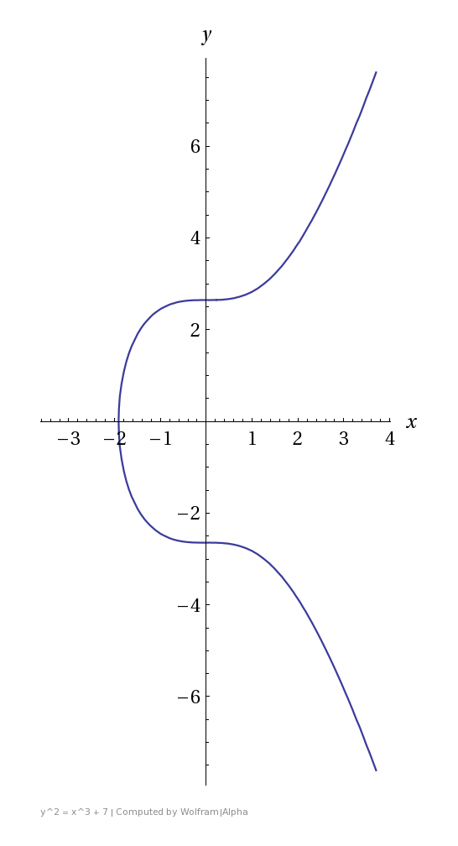
Elliptic Curves
secp256k1 : Y² = X³ +7
Bitcoin’s Elliptic Curve
Elliptic-curve cryptography (ECC) is an approach to public-key cryptography based on the algebraic structure of elliptic curves over finite fields.
ECC requires smaller keys compared to non-EC cryptography (based on plain Galois fields) to provide equivalent security.
Elliptic curves are applicable for key agreement, digital signatures, pseudo-random generators and other tasks. Indirectly, they can be used for encryption by combining the key agreement with a symmetric encryption scheme.
They are also used in several integer factorization algorithms based on elliptic curves that have applications in cryptography, such as Lenstra elliptic-curve factorization.
An elliptic curve is defined by the following affine, long Weierstrass form:
We usually consider the short Weierstrass form:
For the most part, all you need to know about elliptic curves is that they provide another finite abelian group with certain desired properties.
https://en.wikipedia.org/wiki/Elliptic-curve_cryptography
Notes:
https://en.wikipedia.org/wiki/Abelian_group

Slide 13
Elliptic Curves - Group Law
Q
One can define a group law on an elliptic curve using the chord-tangent process.
Given two elliptic curve points, P and Q, we define P × Q as the following:
We find the line intersecting P and Q, which must intersect with one final point, R. If we then reflect R across the x-axis, we obtain another point which we define as P × Q.
R
P
P × Q
Notes:
https://en.wikipedia.org/wiki/Circle#Area_enclosed

Slide 14



Elliptic Curves - Group Law
Q
More formally,
Over certain curves and finite fields, this forms a cyclic (or nearly cyclic) finite abelian group.
R
P
P × Q
Notes:
https://en.wikipedia.org/wiki/Abelian_group

Slide 15

Elliptic Curves - Group Law
R
If P = Q, we find the tangent at P, extend it to the point, R, then reflect across the x-axis to P².
P
P²

Slide 16
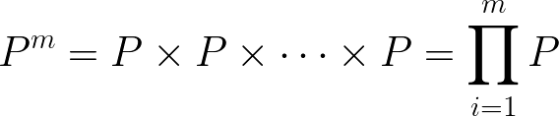

Elliptic Curve Discrete Logarithm Problem (ECDLP)
For some positive integer, m, we can define:
It is believed that finding m given P and P^{m}
is computationally difficult over certain finite fields and certain curves.
As such the ECDLP forms the basis of elliptic curve cryptography.

Slide 17
ECDLP
Compared with discrete logarithms over vanilla finite fields, the elliptic curve discrete logarithm problem has no known, sub-exponential algorithms (assuming the curve is not supersingular or otherwise anomalous).
The fastest, practical algorithm for elliptic curve discrete logarithms is parallel Pollard’s Rho, which runs in O(N^{1/2}).
To achieve security equivalent to a 128-bit block cipher, we need to choose a curve of group order ≈ 2²⁵⁶.
Compare this with RSA or other factoring-based algorithms, which requires ≈ 2048 bit keys for equivalent security.
Notes:
anomalous adj. 不规则的; 不协调的; 不恰当的; 破格的;

Slide 18
Digital Signature Schemes

Slide 19
Digital Signature Schemes (DSS)
Similar to a handwritten signature.
Other people can verify that a message with your signature was, in fact, written by you.
Likewise, it should be difficult to forge a signature without you.
Example: Signing a text file with my gpg key
> echo “Hello, world!” > a.txt && gpg --sign a.txt && base64 a.txt.pgp
owEBTQKy/ZANAwACAXUyGnahI6...QrdcG/B0kkRUmnObdDF7hT/0b9wTg=
The GNU Privacy Guard. GnuPG is a complete and free implementation of the OpenPGP standard as defined by RFC4880 (also known as PGP). GnuPG allows you to encrypt and sign your data and communications; it features a versatile key management system, along with access modules for all kinds of public key directories.
Notes:
https://gnupg.org/

Slide 20
DSS Security Definitions
The (message, sig) recipients desire the following properties:
Message integrity - the message hasn’t been modified between sending and receiving.
Message origin - the message was indeed sent by the original sender.
Non-repudiation - the original sender cannot backtrack and claim they did not send the message.

Slide 21
Digital Signature Schemes
More formally, a digital signature scheme consists of two algorithms:
A signing algorithm, Sign, which uses a secret key, sk.
s = Sign(m, sk), s is the signature for some message, m.
A verification algorithm, Verify, which uses a public key, pk.
valid = Verify(Sign(m, sk), pk), invalid = Verify(s’, pk) for all s’ != s.

Slide 22
ECDSA : Elliptic Curve Digital Signature Algorithm
ECDSA is defined by:
E: an elliptic curve.
g: a generator point of the elliptic curve with large prime order, p.
p: a large, prime integer where g^{p} = O.
H: a cryptographic hash function.

Slide 23
ECDSA - Setup
The signer creates:
The secret key, sk, chosen randomly from [0, …, p-1].
The public key, pk = g^{sk}, which should be distributed publicly.

Slide 24
ECDSA - Sign
Sign(m, sk):
h = H(m) Hash the message
z = h[0 : log₂ p] Take the log₂ p left-most bits of h
k = randomly chosen from [1, …, p-1] k must be kept secret!
r = x-coord(g^{k}) (mod p) x-coord(P = (x, y)) = x
s = (z + sk ∙ r) ∙ k⁻¹ (mod p)
return (r, s) The signature for our message

Slide 25
ECDSA - Verify
Verify(r, s, m, pk):
z = H(m)[0, …, log₂ p]
a = z ∙ s⁻¹ (mod p)
b = r ∙ s⁻¹ (mod p)
v = x-coord(gª ∙ pk^{b}) (mod p)
return valid if v ≡ r (mod p), otherwise invalid

Slide 26
ECDSA - Quick Proof Sketch
Let w = s⁻¹
gª ∙ pk^{b} = g^{z∙w} ∙ g^{sk∙r∙w}
= g^{z∙w + sk∙r∙w}
= g^{(z + sk∙r) ∙ w}
= g(z + sk∙r) ∙ (z + sk∙r)^(-1)∙ (k^(-1))^(-1)
= g^{k}
v = x-coord(gª ∙ pk^{b}) (mod p)
= x-coord(g^{k}) (mod p)
= r (mod p)
ECDSA signatures are used in Bitcoin to show proof of ownership of the outputs of a transaction!

Slide 27
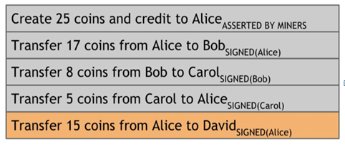
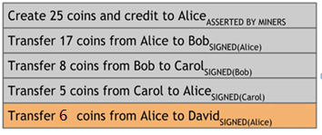
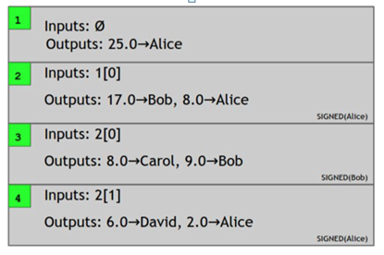
Account-based vs. Transaction-based ledger
Account-based
must track every transaction affecting Alice
Requires additional maintenance, error-prone
Bitcoin is a transaction-based ledger (triple-entry accounting).
Features:
Change addresses - Required since tx outputs only spent once
Efficient verification - only read recent history
Joint payments - Alice + Bob form 1 tx
(Credit for content organization and figures goes to Princeton textbook)
Notes:
In this section I'm going to be talking about the technical quirks and implementation of Bitcoin. It's a lot of material very specific to Bitcoin, but you'll get a feel for the design philosophy of Bitcoin. In general, Bitcoin is optimized to be extremely simple and robust, leaving as little room for error as possible.
Another thing to think about is that Satoshi Nakamoto designed all this. Imagine how intelligent and well-versed to need to be to be able to create a specification like this.
Test: the notes were update

Slide 28
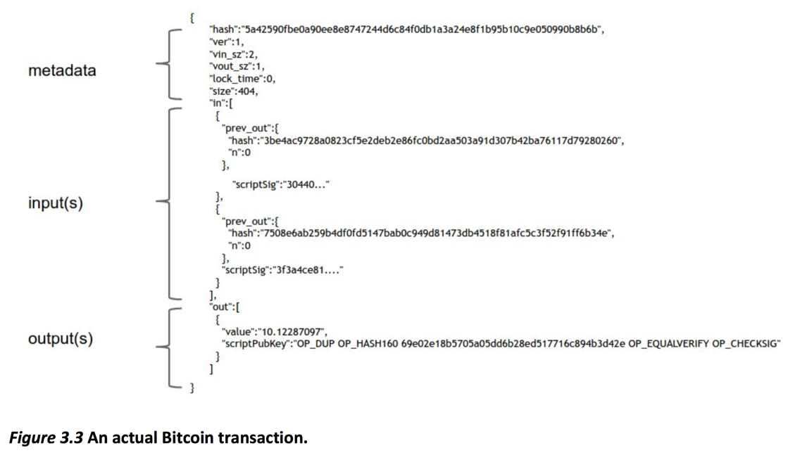

Contents of a Bitcoin Transaction
hash of this tx
version
# of inputs/outputs
Lock time: Useful for scripting
data size (404 bytes)
hash of previous tx
index of output of previous tx
input script
signature (proof of ownership)
output amount
output script
Notes:
So let's take an even closer look at what transactions are. This is very close to the actual representation of a Bitcoin transaction, it's not just not byte-encoded.
- There's some metadata, inputs, and outputs
- In the metadata, there's some housekeeping data (ver, vin_sz, vout_sz), hash (serves as unique ID of the transaction), and locktime, which is useful for bitcoin scripting. We'll talk more about locktime in our scalability lecture
- In the inputs, we have the transaction id (which is the hash of the referenced transaction), and the index of the output in the previous transaction. We also have scriptSig, which is the signature used to redeem the previous transaction output.
- In the outputs, we have a value, and a Bitcoin script.

Slide 29
Bitcoin Scripting

Slide 30
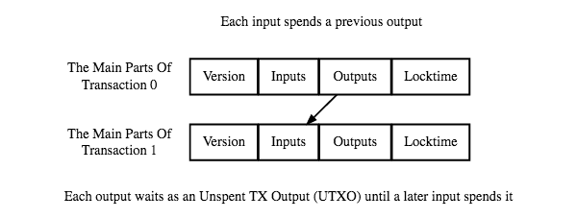
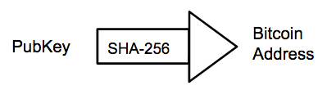
Bitcoin Scripting
(Bitcoin.org developer guide)
Output "addresses" are really scripts.
Inputs and outputs through scripting allows for future extensibility of Bitcoin.
Remember:
Signatures prove ownership of a public key
Bitcoin Address == Hash(PubKey)
Transaction composed of input and output addresses
Spending Bitcoin is redeeming previous transaction outputs
"This amount can be redeemed by a signature from owner of address X"
No way to get the public key from the address!
"This amount can be redeemed by the public key that hashes to address X, plus a signature from the owner of that public key"
(Quotes from Princeton textbook)
Notes:
Each output doesn't simply specify an address, it specifies a script. Inputs are scripts also!
- Why use Bitcoin scripts instead of simply assigning public keys? It allows for more functionality and extensibility of Bitcoin.
Here are the semantics of an output.
(go through points)
So, let's walk through an example
redeeming adj. 补偿的，弥补的,实践; 解救; 使…免受责难

Slide 31
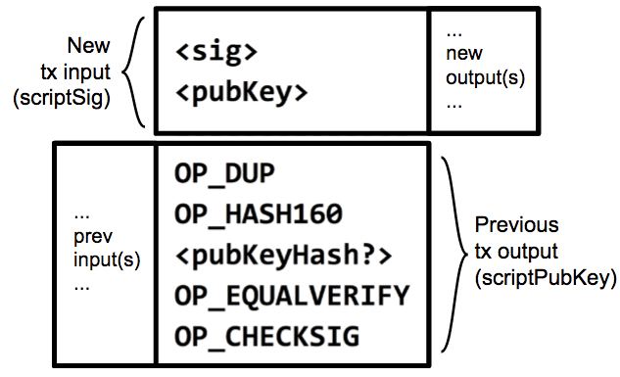
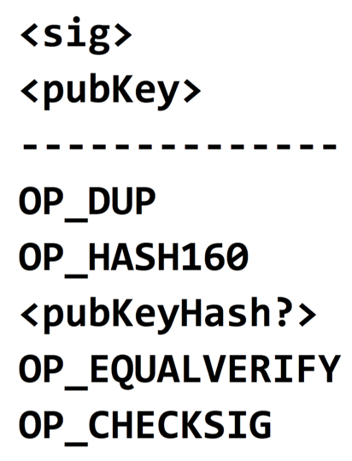
Bitcoin Scripting
PubKey
SHA-256
PubKeyHash
Remember: Hash(PubKey) == Address == "PubKeyHash"
Figure:
Two transactions along with their input and output scripts
...
new output(s)
...
New
tx input
(scriptSig)
Code Execution
1 <sig>
2 <pubKey>
3 OP_DUP
4 OP_HASH160
...
...
prev
input(s)
...
Previous
tx output (scriptPubKey)
Notes:
- To make the input script work with the output script, you simply concatenate them, with the input script coming first.
- This is really hacky, I know, but apparently this is how we like to do everything in Bitcoin.
- The formal terms for these is that our input script is called a scriptSig, and our output script is called our scriptPubKey
- This is because our output script specifies a public key, and our input script specifies a signature for that public key.
- Putting a scriptSig and a scriptPubKey together results in a working script that Bitcoin clients can run to verify that a redeeming transaction is valid.
- Let's take a closer look at how the script actually executes.

Slide 32
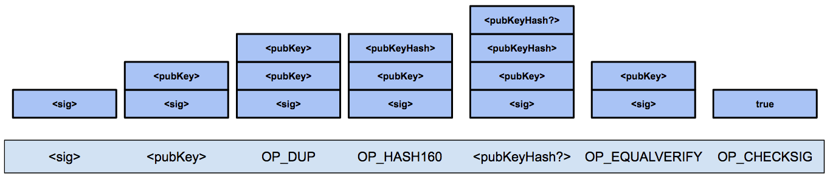
Bitcoin Scripting
Output says: "This amount can be redeemed by
1) the <pubKey> that hashes to address <pubKeyHash?>
2) plus a <sig> from the owner of that <pubKey>
...that will make this script evaluate to true."
Language built specifically for Bitcoin called "Script" or simply "the Bitcoin scripting language"
Stack based
Native support for cryptography
Simple
<pubKeyHash?>
<pubKey>
<pubKeyHash>
<pubKeyHash>
<pubKey>
<pubKey>
<pubKey>
<pubKey>
<pubKey>
<sig>
<sig>
<sig>
<sig>
<sig>
<sig>
true
<sig>
<pubKey>
OP_DUP
OP_HASH160
<pubKeyHash?>
OP_EQUALVERIFY
OP_CHECKSIG
Notes:
Bitcoin uses a language built specifically for Bitcoin called "Script" or "the Bitcoin scripting language."
- It's stack based, has built in instructions for cryptography like hashing and verifying signatures. It also has some reserved opcodes that will allow for the future extensibility of Bitcoin.
- It is very simple. Notably, it's not Turing-complete, which basically means that is very restricted in the logic that it can write.
- There's also no loops, which makes things easier since we don't have to worry about people writing infinite loops and stalling clients trying to verify transactions.
Walking through this example transaction:
- These first two instructions are from the input script (scriptSig) and specify the signature and public key. They're simply data instructions, so all you do is push these values onto the stack
- OP_DUP simply duplicates the topmost item on the stack
- OP_HASH160 hashes the topmost item on the stack. Remember that this pubKeyHash came from the input of the redeeming transaction, so it was specified by the recipient.
- This new <pubKeyHash?> came from the output script, so it was specified by the sender of the coins. In other words, in order to redeem this output, the receiver must provide the signature corresponding with the <pubKeyhash?> provided by the sender of the coins.
- Now, at the top of the stack we have <pubKeyHash?>, the address as specified by the sender, and <pubKeyHash>, the address that the recipient supplied in order to redeem these coins.
- We run an OP_EQUALVERIFY to check if the top two values at the stack match. If they don't match, it throws an error, otherwise the script continues execution.
- Lastly, OP_CHECKSIG checks the top two values on the stack and determines if they are a valid pubKey and signature. It replaces these values with true if so.
- Therefore, this script returns true and this new transaction has a valid redeeming script.

Slide 33
Proof of Burn

Slide 34
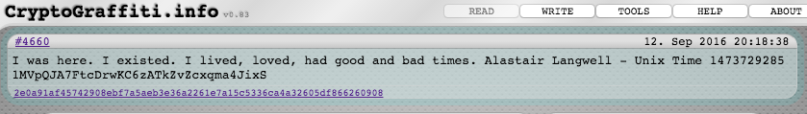
Proof of Burn
How to write arbitrary data into the Bitcoin blockchain?
Proof of Burn
OP_RETURN throws an error if reached
Output script can't be spent, therefore you prove that you destroyed some currency
Anything after OP_RETURN is not processed
Use cases
Prove existence of something at a particular point in time
Ex. A word you coined, hash of a document/music/creative works
Bootstrap CalCoin by requiring that you destroy some Bitcoin to get CalCoin
OP_RETURN
<arbitrary data>
<harambe>
Output script:

Slide 35
Pay-to-PubkeyHash vs. Pay-to-Script-Hash
In Bitcoin, senders specify the script.
P2PKH: Vendor says "Send your coins to the hash of this PubKey."
Simplest case
Is by far the most common case
But for complicated scripts (such as multisig), this can be a problem.
Ex. Vendor says "To pay me, write a complicated output script that will allow me to spend using multiple signatures."
How would the sender know?
Notes:
Let's go back to scripting to clarify an important detail. If you ever want to do Bitcoin development, it's important to know these primitives.
In Bitcoin, senders write a script such that the recipient of the funds is able to redeem that transaction.
- The execution that we walked through 2 slides ago was an example of something called Pay-to-PubkeyHash.
- It's the simplest and most common case, where you're just spending to the hash of someone's public key.
But for complicated scripts, the sender of the coins would still need to specify the script exactly, which can be a problem.
- For example, what if you go to a store and all you want to do is make a transaction and leave.
- But your vendor says "Wait! We use multisig now. You'll need to write a complicated output script that will allow us to spend using multiple signatures. By the way, you can't make any errors, otherwise your money will be lost forever."
How would the sender know how to write this script?

Slide 36
Pay-to-PubkeyHash vs. Pay-to-Script-Hash
Solution? Pay-to-Script-Hash (P2SH)
P2PKH: "Send your coins to the hash of this PubKey."
P2SH: "Send your coins to the hash of this script. To redeem those coins, you must reveal the script that has the given hash and provide data that will make the script evaluate to true."
Offloads complicated script writing to recipients
P2SH is the most important improvement to Bitcoin since inception
Notes:
Bitcoin gets around this by introducing something called Pay-to-Script-Hash.
Pay-to-Script-Hash says "Send your coins to the hash of this script. To redeem those coins, you must reveal the script that has the given hash and provide data that will make the script evaluate to true."
- Now, we've essentially offloaded the complicated script writing to the recipient of the funds.
- This makes more sense from a payer-payee standpoint because if a company wants to receive money and use complicated features such as multisignature, they don't burden their customers by forcing them to write complicated scripts. They simply write the script themselves and give the hash of the script to the customer.
- The customer doesn't care what the script actually is - all they care about is getting their goods. It's up to the company that they write the correct output script so that they and ONLY they are able to redeem that output.
- It also makes sense in that the customer shouldn't need to know anything about how the company holds their funds in order to be able to easily send them money.
- Pay-to-Script-Hash is a clever trick that has turned out to be the biggest enhancement to Bitcoin since Bitcoin was created.

Slide 37
Merkle Tree

Slide 38
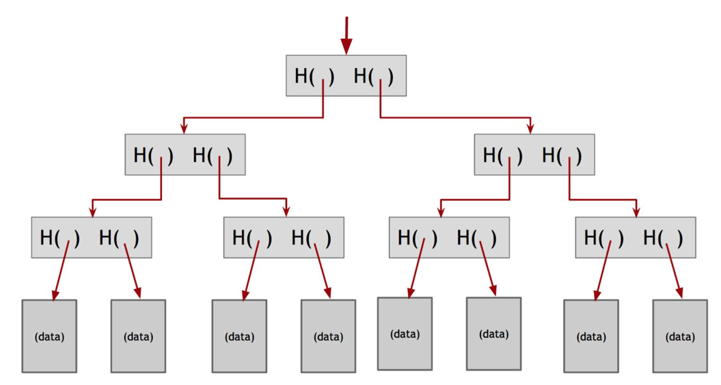
Merkle Tree
Merkle Root
A binary tree of hash pointers
Hashes are hashed together
This allows you to prove that your data existed in the tree corresponding to the Merkle Root without actually saving all of the data in the tree.
For example, if you had a message in this 3rd node at the bottom, to prove inclusion in the tree you simply have to save these three intermediate hashes in the tree and show that you are able to produce the Merkle Root with this data.
Princeton Textbook Figure 1.7
Notes:
So now let's cover Merkle Trees and the Bitcoin data structure a little bit more formally.
In its most general form, a Merkle Tree hashes a number of blobs of data and hashes those hashes together, ending up with a single hash called the Merkle Root.
In computer science terms, it's a binary tree of hash pointers.

Slide 39
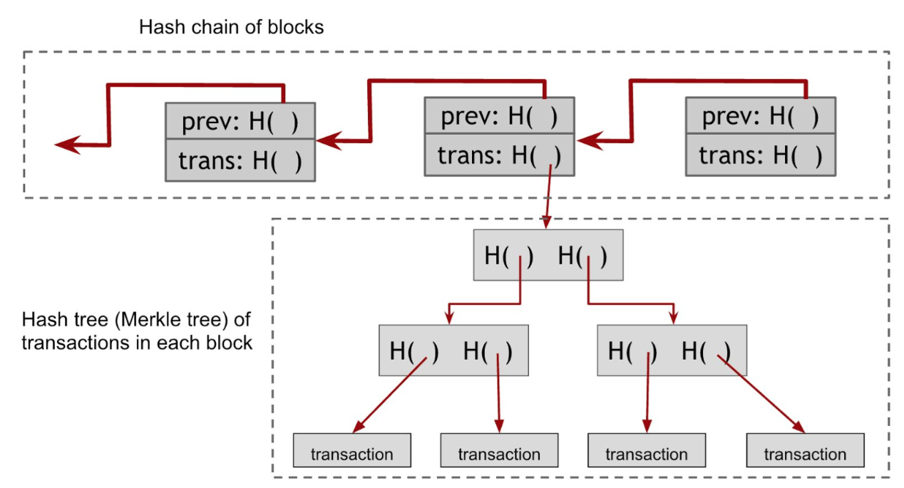
Merkle Tree - Bitcoin construction
Transactions are leaves in the Merkle tree, includes a coinbase transaction
Two hash structures
Hash chain of blocks
These blocks are linked together and based off of each other.
A Merkle tree of txs, internal to each block
Princeton Textbook Figure 3.7/3.8
Notes:
Now, this was probably obvious to you already, but in Bitcoin, the leaves of the Merkle tree we use are simply the transactions in the block.
(go over points)
- hash chain is tamper resistant
- merkle tree duplicates transactions to fill in gaps

Slide 40
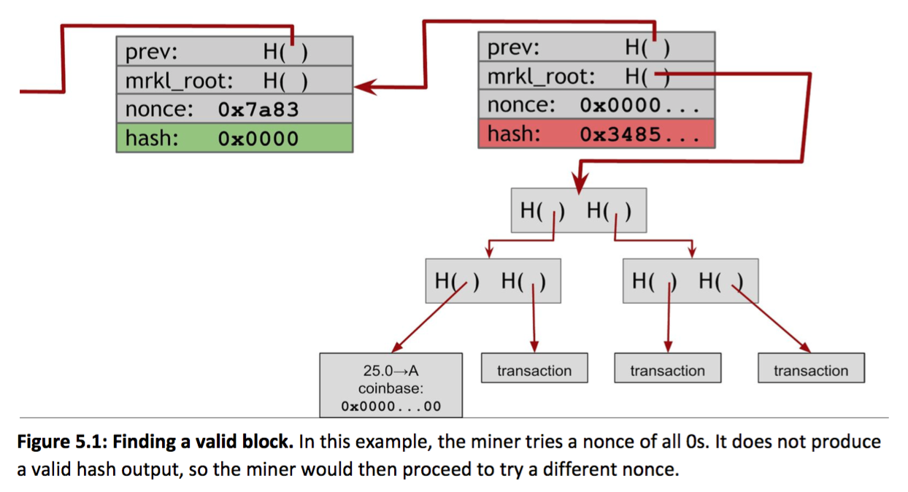
Merkle Tree - Mining, in more detail
Previously, hash of:
Merkle Root
PrevBlockHash
Nonce (varied value)
below some target value.
Actually two nonces:
In the block header
In the coinbase tx
Hash of
PrevBlockHash
Coinbase nonce (varied value)
Affects the Merkle Root
Block header nonce (varied value)
Princeton Textbook
Notes:
We covered the mining math problem previously, but now that we know the data structure, we can take a closer look.
- Previously, we said that mining was hashing the Merkle Root, previous block hash, and varying a nonce to try to find an output below some target value.
- Well, in Bitcoin, there's actually two nonces. There's one in the block header, which is what we were referring to before, and there's one in the coinbase transaction.
- Remember that the Coinbase transaction is a special transaction in each block that allows the miner who found the solution to reward themselves with some Bitcoin.
- But in what order do you vary these nonces? Why do we need two nonces?

Slide 41
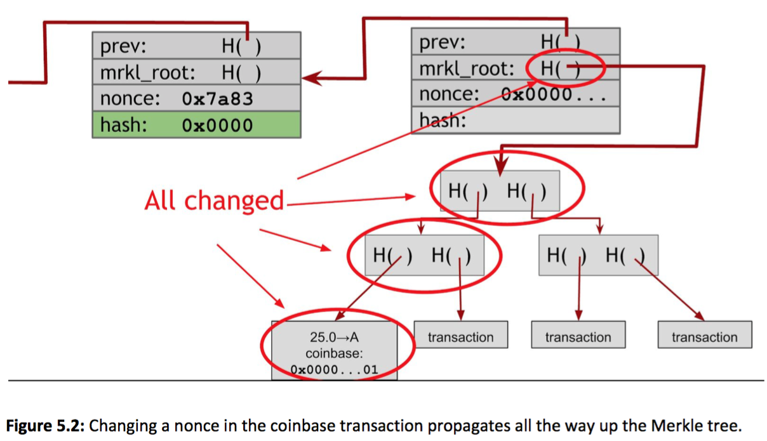
Merkle Tree - Bitcoin construction
What if there is no solution?
Block header nonce is 32 bits
Antminer S9 hashes 14 TH/s
How long does it take to try all combinations?
2^32 / 14,000,000,000,000 = 0.00031 seconds
Exhausted 3260 times per second
Therefore, must change Merkle root
Increment coinbase nonce, then run through block header nonce again
Incrementing coinbase nonce less efficient because it must propagate up the tree
Princeton Textbook
Notes:
We need two nonces because the block header nonce is 32 bits.
(go over points)
6 things you need to know before buying an Antminer s9 1. The Antminer s9 the most powerful miner available on the market The Antminer s9 has a hash rate of 12.93TH/s -+ 7% (and not 14 TH/s as advertised sometimes), which means that it can generate around 0.5 Bitcoins every month. This is of course only revenue and not taking into account the electricity, mining pool fees, or hardware expenses. I ran the numbers against 3 different Bitcoin mining calculators and they all show the same result. Around $330 a month of pure revenue (at today’s exchange rate this equals around 0.5 BTC). The Antminer S9 is also the most efficient miner on the market. This means that it wastes the least amount of energy than all other miners out there. If you add into account electricity cost as well you will generate a little less than that – around 0.33BTC. 2. The Antminer s9 is the most expensive miner on the market The price of the Antmier s9 varies a lot. On Bitmain’s site you can buy it for $2400 or at a similar price on Coinminer. On Amazon you can find it for as little as $2700 and on eBay you can get it for as little as $2000 (so that’s probably the best place to look). This is the most expensive miner on the market today because its superior mining abilities. In order to break even with your investment you will need to mine for about 10 month taking into account an average electricity cost of $0.1/KW. 10 months is a long time in the Bitcoin universe and a lot can change – mining difficulty can rise, exchange rate will fluctuate and all of these make it hard to predict how long will it actually take to break even in this investment. 3. You need an additional PSU to run the Antminer s9 The Antminer s9 can’t just be plugged into the wall, it needs a PSU (power supply unit). So whenever you purchase an Antminer keep in mind that you will need to spend and additional $150 on a PSU. Bitmain (Antminer’s manufacturer) recommends using APW3-12-1600-B2 which can be found on their website, on Amazon or on eBay at different price points as well. Here’s how to set the miner up with the power supply (notice how loud the miner gets once you operate it): If you own a PSU of an old Bitcoin miner you might be able to use that as well. For example the EVGA SuperNOVA 1300 Watt GPU PSU should also work with this miner. However if you don’t already own a compatible PSU it will probably be best to just buy the APW3-12-1600-B2 and add it to your initial investment cost. It probably won’t cost much more than any other old PSU you can find. 4. You may want to consider getting a bunch of S7s instead of one Antminer S9 Seeing as most people will probably rush to buy the new Antminer s9 you may want to consider getting the older model (Antminer s7) at a discounted price due to lower demand. The Antminer S7 has about 33% of the hashing power of the s9 (it runs at 4.73 TH/s) but if you buy 3 used ones it will probably cost less. Here’s what one experienced miner had to say about the Antminer s9: My overall rating is a 3.5 since these don’t deserve a 4. These are great miners that can replace about 3 s7s. However, the miner gets way too hot over the s7s. I can easily run my 5 s7s in my garage in florida at 55% (which I have to because any higher and they make a loud whinny noise) while these are kept at 100% and still get too hot. I can easily keep these at 100% with no whinny noise issue and are more quiet than the s7. If you do want to use the s9s then they will have to be in a much better controlled environment(which I will have to come up with) if you want to keep these lasting longer. If you do go down this path though it’s important to recalculate profitability as the Antminer s7 is less power efficient than the s9. Here’s a complete comparison of the Bitcoin mining hardware available. 5. Not all Antminer s9s are created equal Bitmain delivers their Bitcoin miners in batches. Every batch is different than the other and also has a different hash rate. So it’s extremely possible that you’ll find yourself buying an Antminer s9 that has a hash rate of only 11.85 TH/s and not 12.93 TH/s. That’s why it’s important to know the specifications of the exact miner you’re looking into before buying it. For example, the current batch of Antminer s9s available from Bitmain are only 11.85TH/s, the more powerful models are sold out. However, on eBay you can still find people selling the older more powerful model. Keep in mind that the 11.85TH/s models are also priced lower than their bigger brother, so it’s not like you’re getting ripped off or anything by buying that model. Bottom line – make sure to know the EXACT specifications of the miner you’re buying. This way you will know to calculate the exact ROI and when you will break even. 6. You get a 90 day warranty on your miner (if bought from Bitmain) Bitmain supply their customers with a 90 day warranty, however that warranty comes with limitations. For example, the warranty won’t be valid if you overclock the miner (running it at a higher speed than it was designed to run). Also, if you use an inappropriate power supply or generate environmental damage to your miner you won’t be eligible for a warranty (e.g. lightning strike, corrosion due to wet environment). Some eBay sellers will also supply you with a warranty so make sure to read the details on each listing careful. Bottom line – is the Antminer s9 worth it? If you’re interested in getting into Bitcoin mining then the Antminer s9 is probably the only logical solution. However the answer to the question “is the Antminer s9 worth it?” is totally personal. It depends on many factors such as: How much money you have available to spend on Bitcoin mining Where you live (i.e. electricity costs, cooling costs) How much do you believe Bitcoin’s value will rise in the future Also there’s always the question of the increasing difficulty and how much time will pass until the Antminer s9 becomes obsolete (usually this happens within 8-12 months). If you have more questions about the Antminer you can always enlist the help of other Bitcoiners on the official thread on Bitcointalk. Happy mining! Read more: Antminer S9 Review - 6 Things You Need to Know Before Buying | 99Bitcoins

Slide 42
Simplified Payment Verification

Slide 43
Simplified Payment Verification (SPV)
Current size of Bitcoin blockchain: 83.3 Gigabytes and growing
300% of what it was 2 years ago
Storing the full Bitcoin blockchain will likely not be feasible for the average user, so how do we address this?
SPV - Simplified Payment Verification
"SPV nodes" or "thin" client, as opposed to "full nodes"
Don't store the full blockchain
Only store the pieces of data needed to verify transactions that concern them
Nearly all nodes on network are SPV nodes
If you use wallet software where you're most likely running an SPV node
Notes:
Current size of Bitcoin blockchain is 83.3 Gigabytes, and growing. In 2014, it was still around 23 GB, which is totally manageable. In the last two years, it's tripled in size. Storing the full Bitcoin blockchain will likely not be feasible for the average user, so how do we address this?
- Well, there is something called SPV, which stands for Simplified Payment Verification.
- Bitcoin nodes that use this are called "SPV nodes" or "thin" clients, as opposed to "full nodes" that store the entire blockchain.
- SPV nodes only store the pieces that they need to verify specific transactions that concern them.
- Nearly all nodes on the Bitcoin network are SPV nodes
- If you use wallet software where you're most likely running an SPV node .

Slide 44
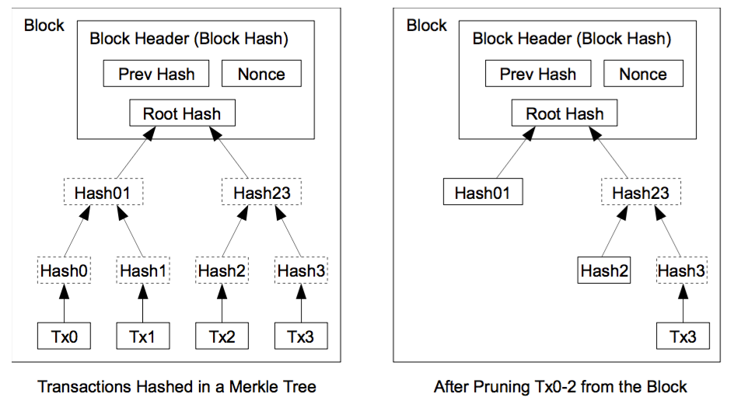
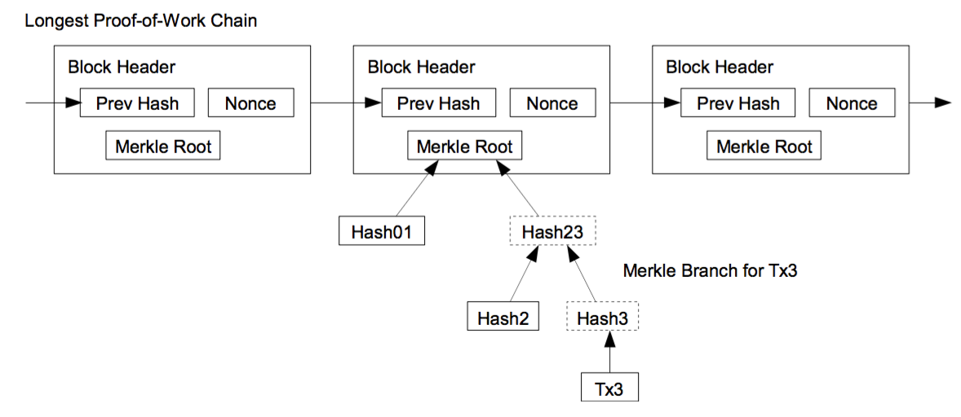
SPV - Structure
SPV nodes only keep block headers of the blockchain
Obtained by querying different full nodes until the node is convinced it has the longest chain
How to validate an incoming tx?
Query full nodes to get the Merkle branch for that transaction
Hash tx together with intermediate hashes to obtain a Merkle root, check that it matches the one saved locally.
Wait for this tx to have enough confirmations before delivering good
Nakamoto, 2009
Stored locally
Queried from full nodes
Incoming tx
Nakamoto, 2009
Notes:
SPV Structure
- Your node will only download and store the full list of block headers.
- All you have to do is query a bunch of different full nodes on the network until you are fairly certain that they aren't all colluding to try to deceive you.
- Plus, the block headers have the proof of work information stored, so you know that it was very hard to create these block headers.
Now, how do you validate an incoming transaction?
- Suppose you are a merchant selling harambe posters online and running an SPV node.
- A customer sends you an incoming transaction.
- The transaction output specifies your Bitcoin address so you know this is an fresh, unspent output. Unless you're weird and want to double spend on yourself.
- Now all you need to verify is that it was included in a block at some point and that this person can't double spend on you.
- You go over to a bunch of your full node friends and ask them to give you the intermediate hashes (the Merkle branch) for this transaction.
- You hash this incoming transaction with all the intermediate hashes going up the Merkle tree until you've gotten a Merkle root.
- You check that this Merkle root is equal to the one that you had stored in your chain of block headers. They're the same. Cool.
- The only part left is to wait the standard 6 confirmations before you dispense your precious harambe posters. You continue to query full nodes until you've have 6 block headers on top of the one the incoming transaction was included in.

Slide 45
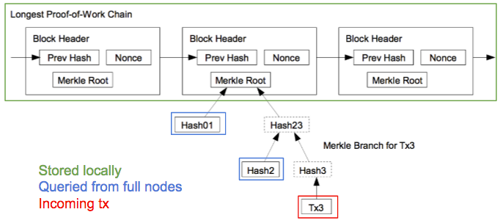
SPV - Security Analysis
SPV nodes:
Don't have full tx history, don't know UTXO set
Don't have same level of security of full nodes
Can't check if every tx included in a block is actually valid
Can only verify transactions that actually affect them, and must do so lazily.
Nakamoto, 2009
SPV nodes assume:
...that incoming block headers aren't a false chain
Very expensive for attacks (or anyone) to create blocks
Not sustainable over the long term
...that there ARE full nodes out there validating all transactions
There are efficiency benefits and incentives to doing so
...that miners ensure that the transactions they include in their blocks are valid
Otherwise their blocks would be rejected by full nodes (very expensive mistake!)
Notes:
Let's think about the security a little bit more.
SPV nodes:
- SPV nodes don't have the full transaction history and doesn't know the set of unspent transaction outputs.
- Therefore, SPV nodes don't have the same level of security of full nodes, since it can't check to see whether every transaction included in a block is actually valid.
- They can only verify transactions that actually affect them, and must do so lazily.
Assumptions
- SPV nodes simply assume that the block headers that they're getting from the full nodes aren't a false block chain
- This is fair because it's really expensive for an attacker to mine these blocks, and the attacker wouldn't be able to sustain this over the long run unless they had over 51% of the mining power
- SPV nodes simply assume that there ARE full nodes out there that are validating all the transactions. There are efficiency benefits and incentives to doing so.
- They assume that the miners creating blocks are ensuring that the transactions they include in their block is valid.
- If the miners didn't check that the included transactions were valid, these blocks would be rejected by the full nodes validating blocks, and thus be a big waste of computational power.

Slide 46
SPV - Cost savings
Huge cost savings
Block headers are only ~1/1000 the size of the full blockchain
83 MB vs. 83 Gigabytes
SPV nodes capitalize on obtaining data for verifying transactions lazily
Could be an issue for big merchants who must verify many txs
Nakamoto, 2009
For most consumers and users of Bitcoin, SPV is a decent tradeoff.
Notes:
(go over points)
SPV nodes capitalize...
- If you are a big merchant and need to verify a lot of incoming transactions all the time, then it's probably worth it for you to keep a full copy of the blockchain so that you're able to do it quickly and efficiently instead of having to query the rest of the network all the time.
- But for most consumers and casual users of Bitcoin, SPV is easy to use and secure enough.
SPV is a decent security tradeoff.
So, given all that we've gone through today, imagine that Satoshi Nakamoto came up with all this. It's now clear why so few people actually understand Bitcoin. I hope you got a good feel of the kinds of thinking you encounter when you're in the space!

Slide 47
Lecture Outline
Hashing Review
Elliptic Curves
Digital Signature Schemes
Bitcoin Scripting
Proof of Burn
Merkle Tree
Simplified Payment Verification

Slide 48









完
Hindi
Traditional Chinese
Thai
Gracias
Russian
Thank You
Spanish
Obrigado
English
Brazilian Portuguese
Arabic
Danke
Grazie
German
Italian
Simplified Chinese
Merci
French
Tamil
Japanese
Korean
Notes:
48

